Slide 1
Texas City Gas Plant HAZOP
Report

Slide 2
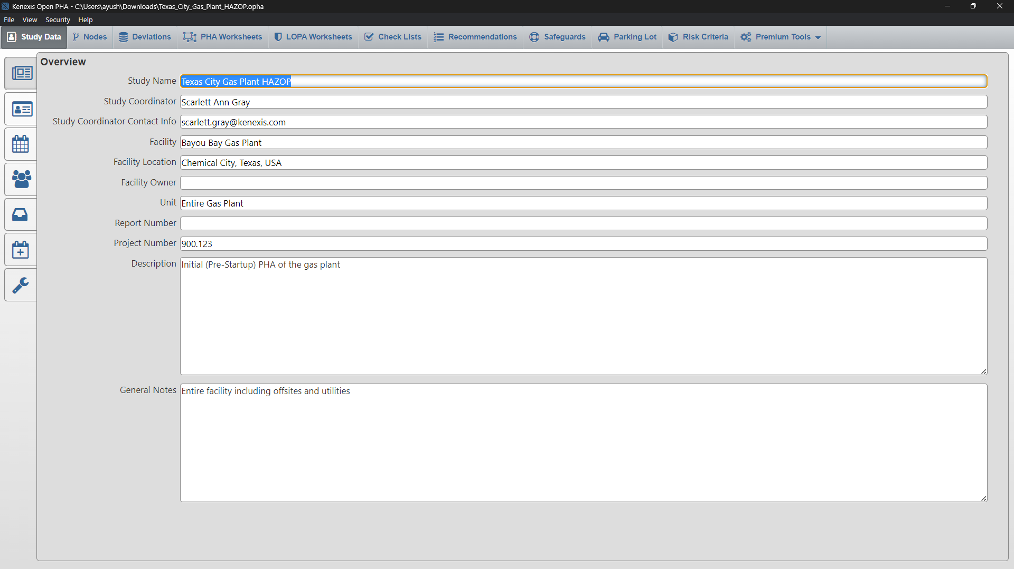
Overview

Slide 3
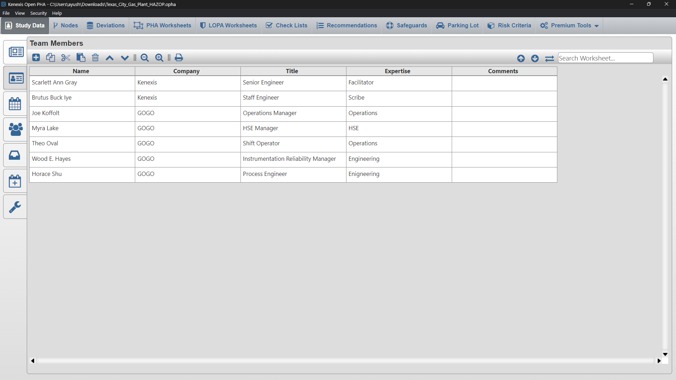
Team Member Data

Slide 4
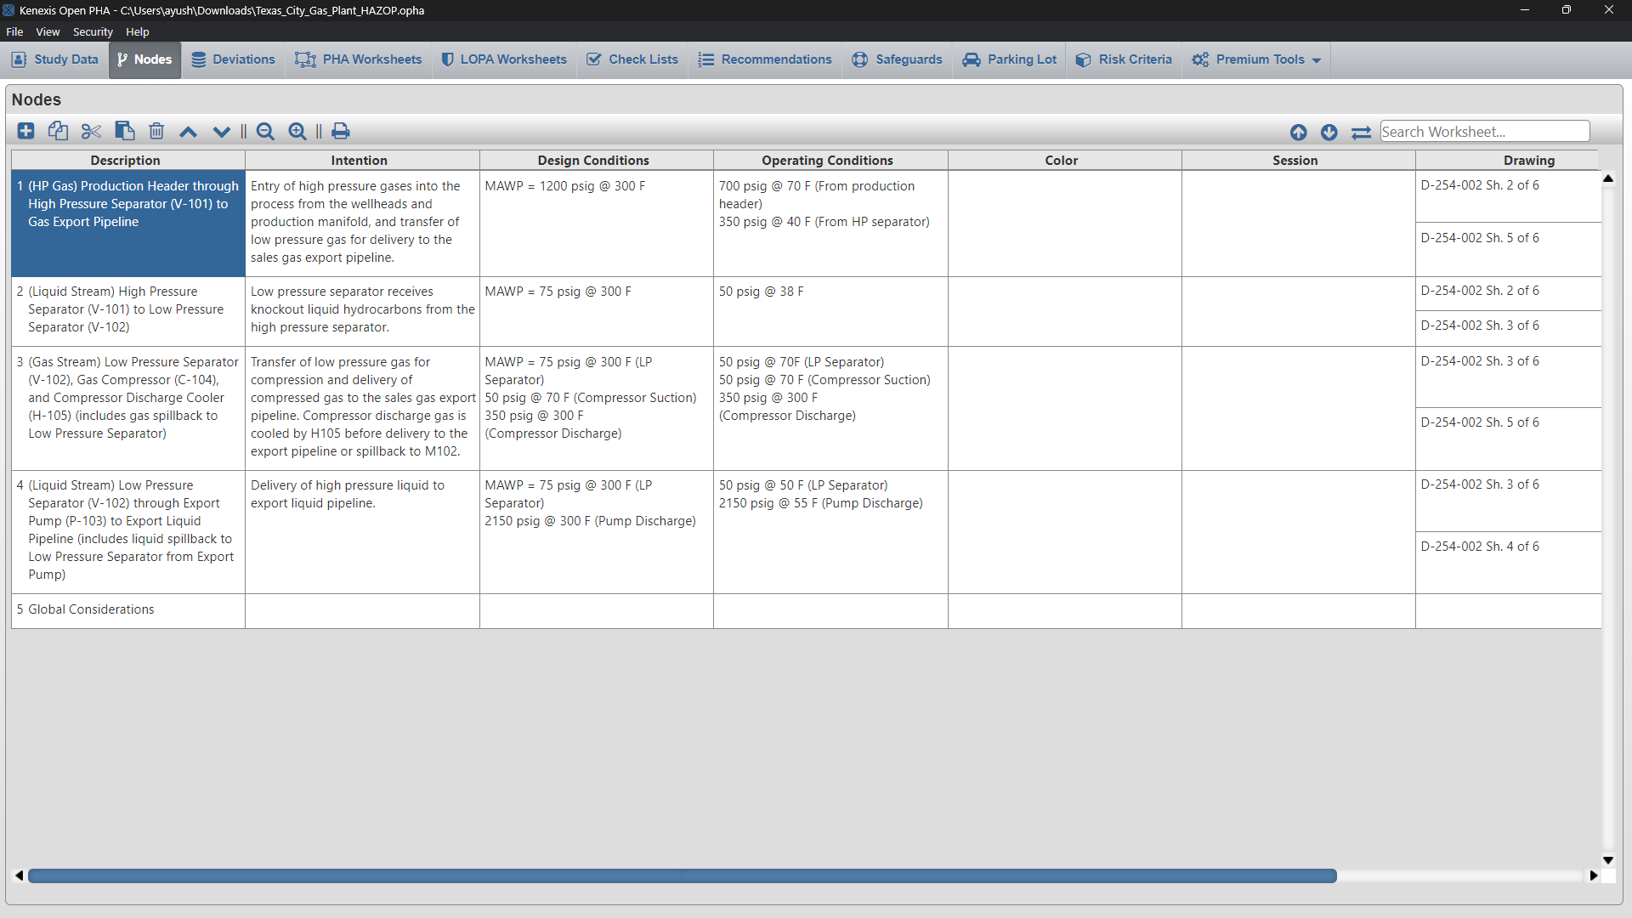
Navigation Toolbar
The navigation toolbar serves as the primary means for navigating the Open PHA study editor interface and appears on all pages in the editor. This section details the available buttons on the toolbar:

Slide 5
Nodes
Processes must be divided into sections for detailed review. In HAZOP studies, nodes are used.
Example- It may be defined as pipe sections and vessels in which process chemicals are, or may be, present. (In Chemical Industry)

Slide 6
Nodes

Slide 7
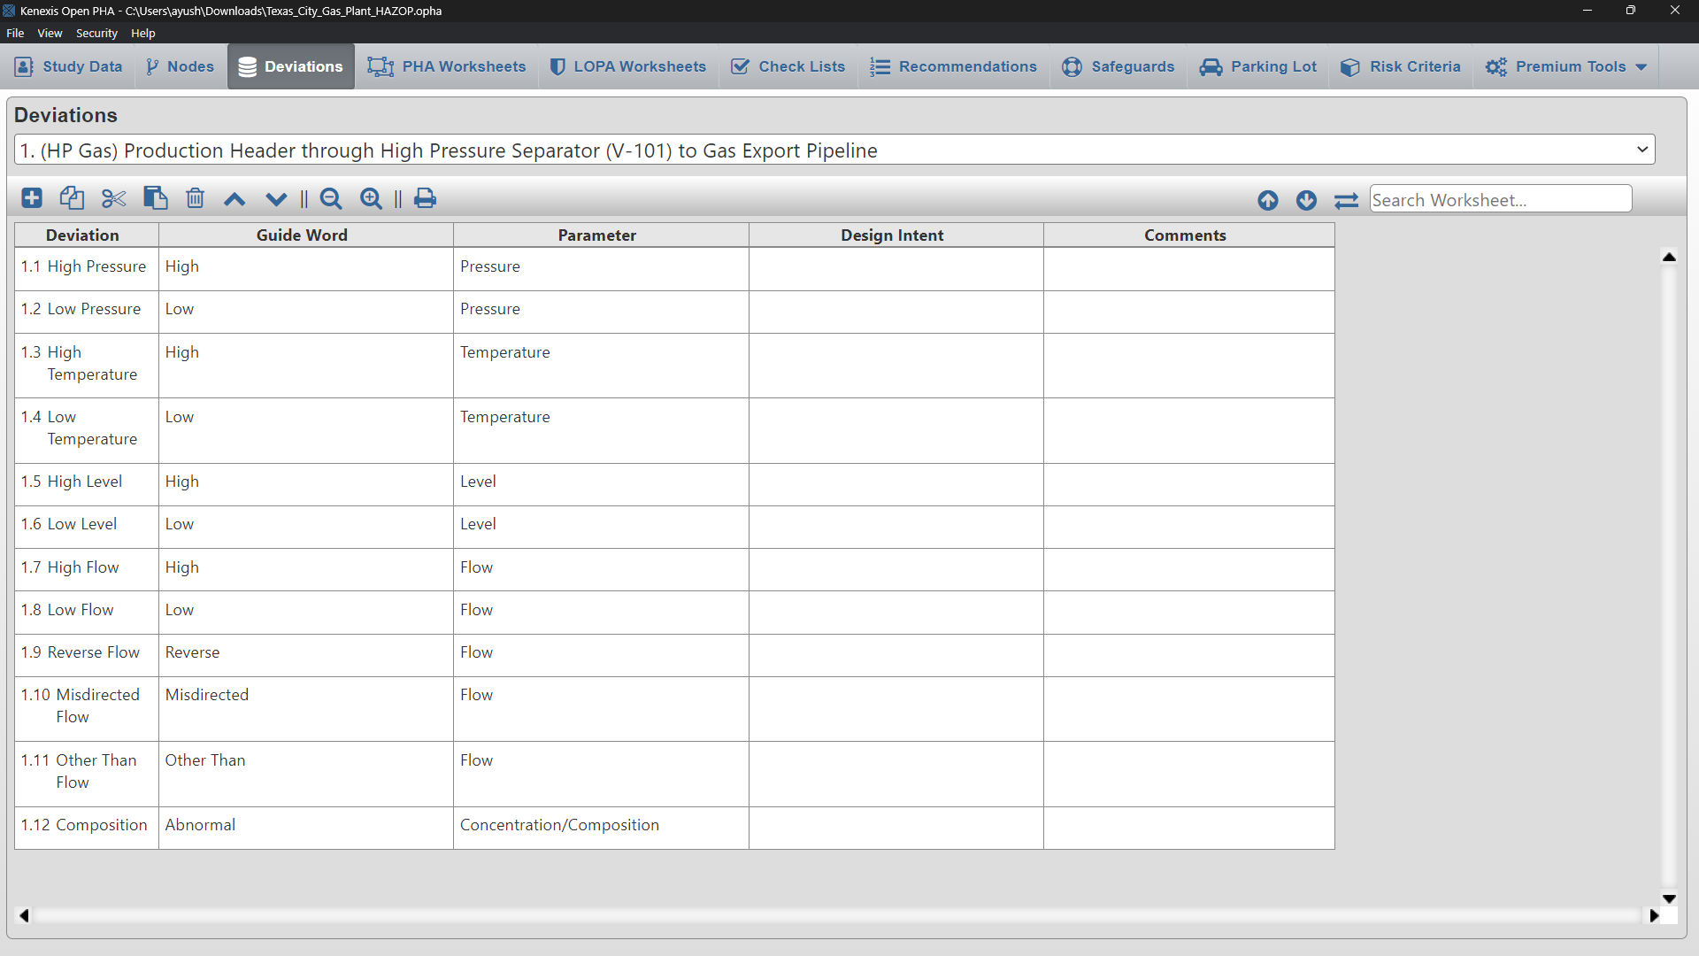
Deviations

Slide 8
PHA Worksheet
The table is a staple of the Open PHA interface and is used extensively creating, editing and maintaining the study’s worksheets.
All tables are provided with a consistent set of controls to allow you to interface with the data in various ways. This section provides a summary of the controls which are typical for tables in Open PHA.

Slide 9
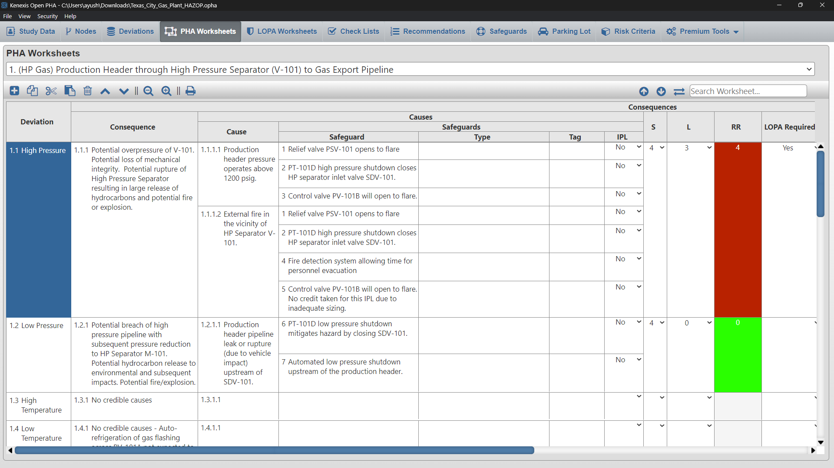
PHA Worksheet

Slide 10
LOPA Worksheets
When opening the PHA Worksheets tab, the workspace will open a blank worksheet prepopulated with deviations from the Deviations Table.
If the Deviations table was not completed prior to starting on the PHA Worksheet, simply enter the deviations into the Deviation column and this will populate the Deviations column in the Deviations table.

Slide 11
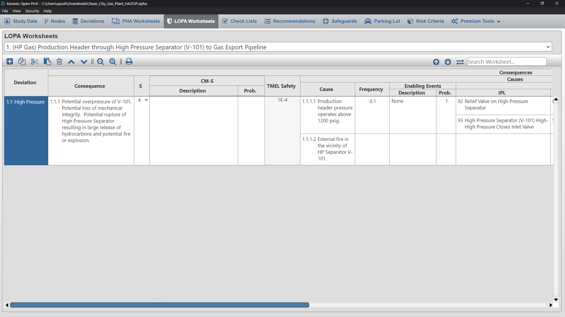
LOPA Worksheets

Slide 12
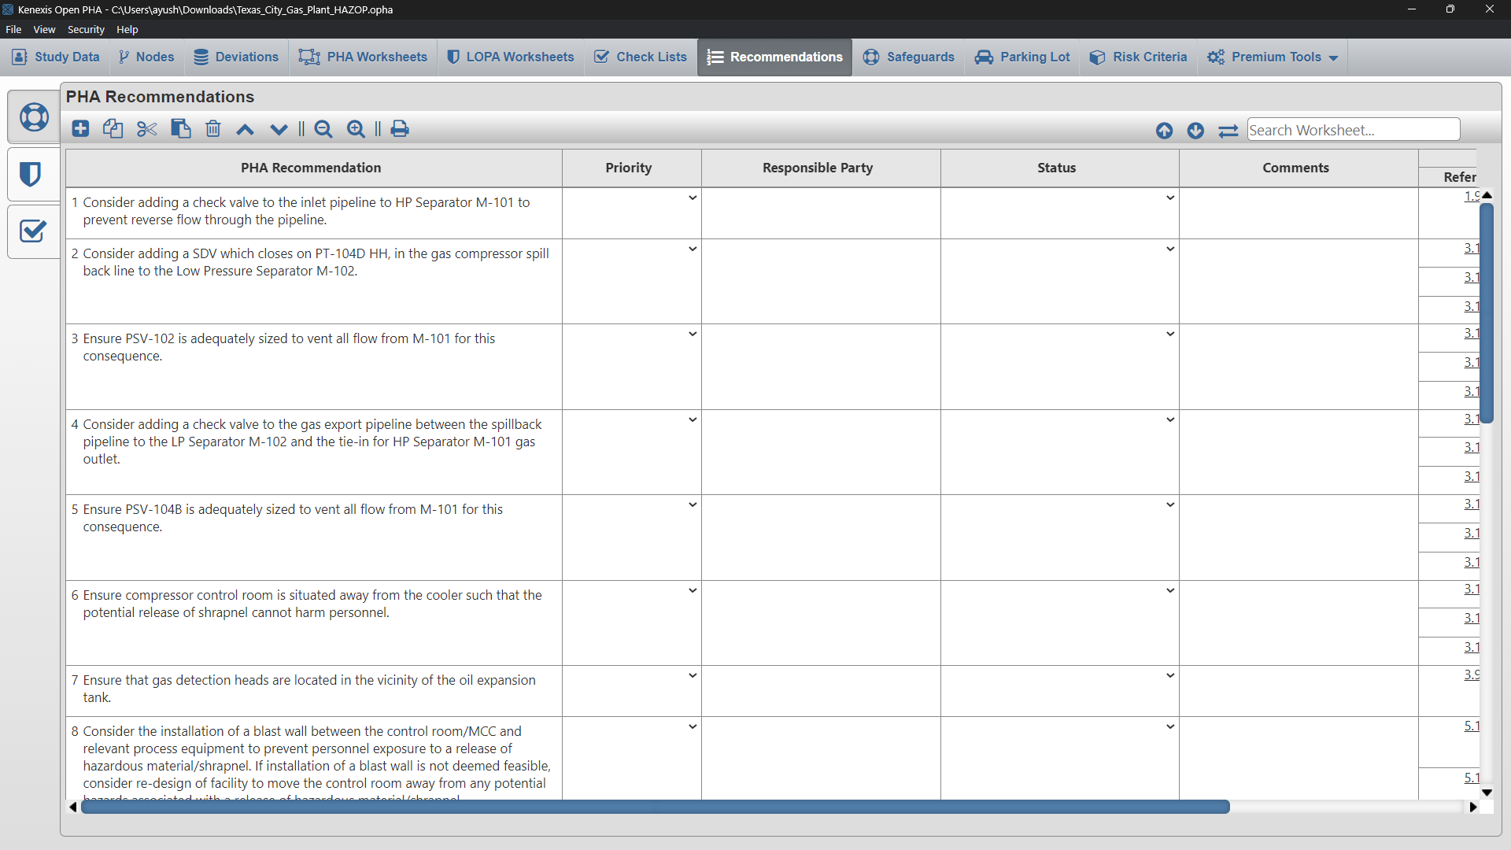
Recommendations

Slide 13
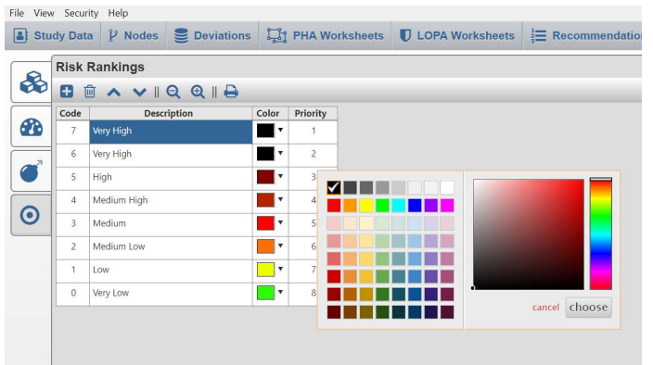
Risk Rankings Page
The Risk Rankings Page houses the risk ranking table. This table allows the user to identify, describe and rank risk. Below is an example of the Risk Rankings Page from a study that uses the explicit LOPA method.

Slide 14
Safegaurds
Safeguards help to protect a process when the system deviates from the safe operating conditions. Safeguards are often utilized in a Process Hazard Analysis (PHAs) or a Hazard and Operability (HAZOP) study as a way to reduce the severity or probability of a scenario that was identified by the risk assessment

Slide 15
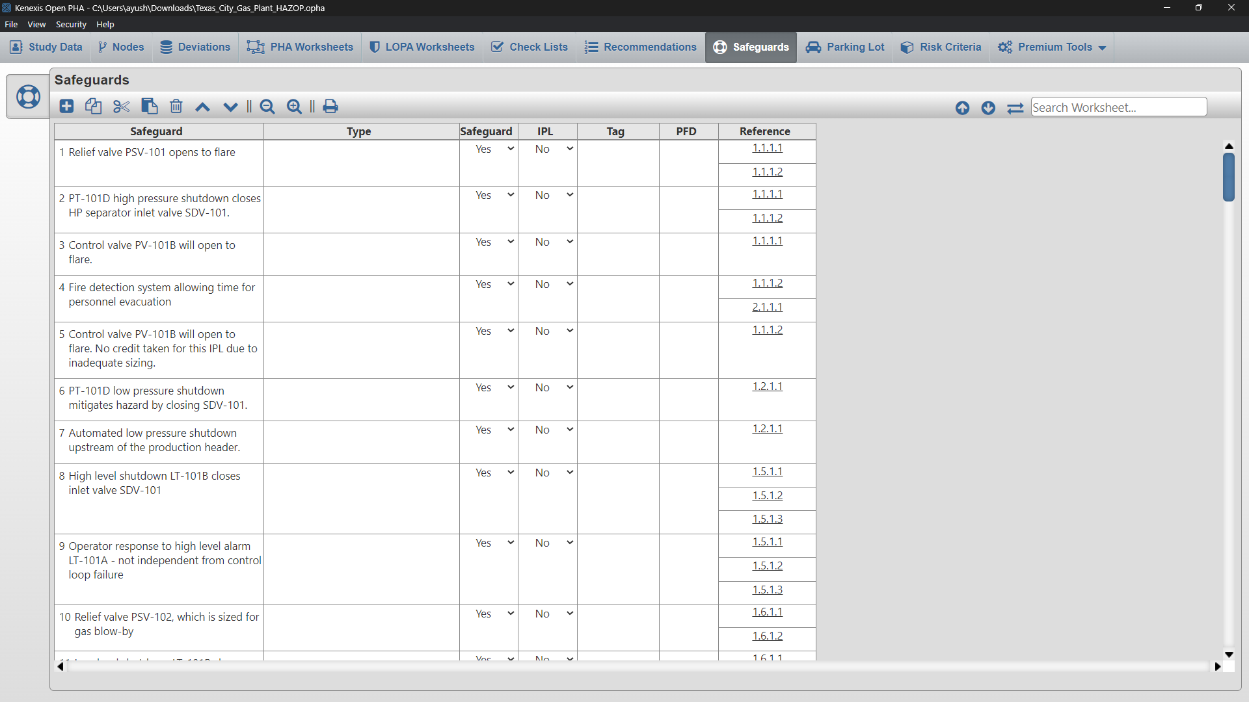
Safegaurds

Slide 16
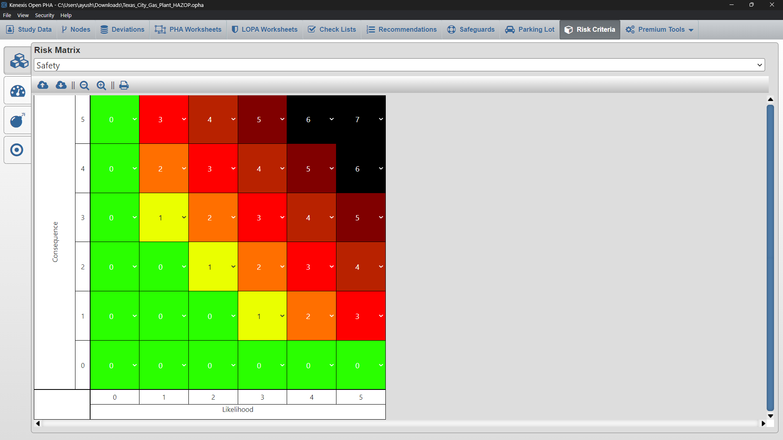
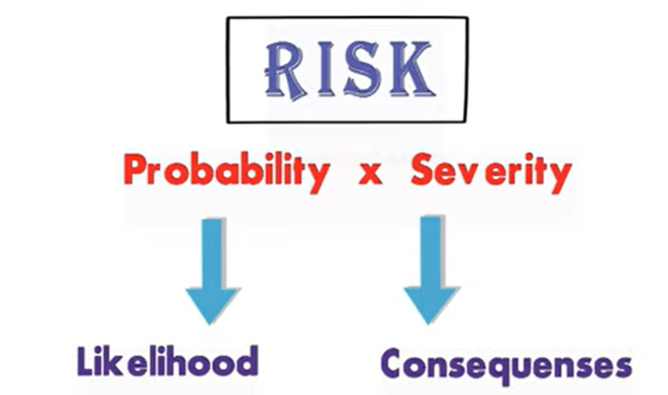
Risk Matrix

Slide 17
Thanks

